Slide 1
IGAT
Internet Gaming Analysis and Trend
FYP Team
Ahmad Waseem 128209
Muneeb Zia 128241
Kainat Shaikh 128155
Supervised by
Ms. Asma Sattar

Slide 2
Project Overview
Problem statement
Description
Use Cases
Web Crawler
Sentiment Analysis
Game Rating
Feature Rating
Comparison
Suggestions

Slide 3
Problem Statement
User have less information about its features.
Difficult to entertain market and general information oriented queries about game’s features

Slide 4
Description
Gaming Trends
Web based portal for game rating
Features rating
Suggestions

Slide 5
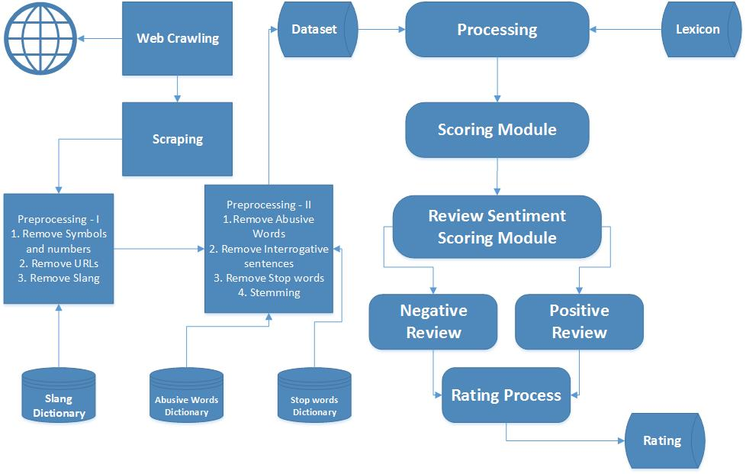
Model Diagram

Slide 6
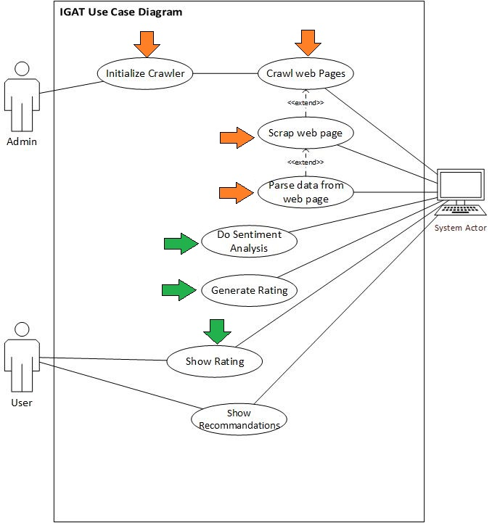
Use Case Diagram

Slide 7
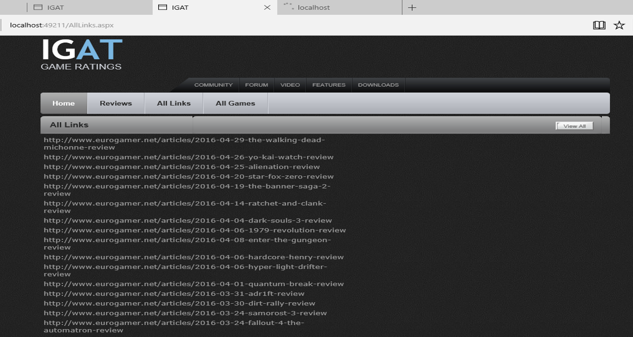
Web Crawler

Slide 8
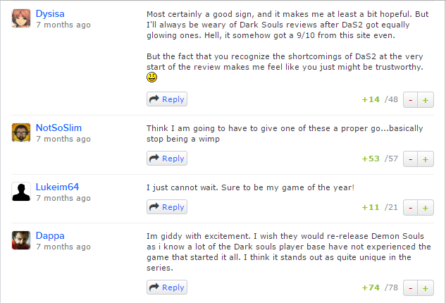
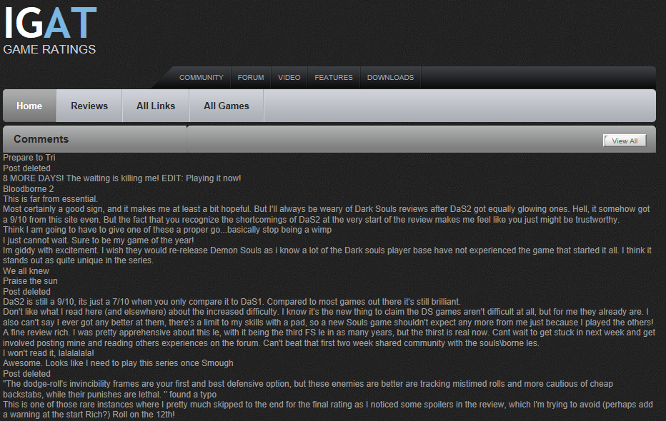
Web Scraper

Slide 9
Preprocessing
Remove Symbols
Remove URLs
Remove Number
Remove slang words
1. This game is awesome. I ******g love playing this game. Watch this similar
game https://www.abc.net/abcGame. Looking forward for TMNT!!!! What do
you think?
This game is awesome. I f****** love playing this game.
Watch this similar game Looking forward for
Teenage mutant ninja turtle. What do you think?
Notes:
I love playing GTA. Its gameplay is ******g awesome. See others www.abc.com/Game123. Do you like these?

Slide 10
Preprocessing
Remove Abuse Words
Remove interrogative Sentence
Remove Stop Words
Stemming
This game is awesome. I f****** love playing this game. Watch this similar game.
Looking forward for Teenage mutant ninja turtle. What do you think?
game awesome. love play game. Watch similar game.
forward Teenage mutant ninja turtle.

Slide 11
Sentiment Analysis
SentiwordNet 3.0*
Sentence Polarity
Dictionary Based Method
*Fellbaum, Christiane (2005). WordNet and wordnets. In: Brown, Keith et al. (eds.),
Encyclopedia of Language and Linguistics, Second Edition, Oxford: Elsevier, 665-670
*http://scholar.google.it/scholar?cites=10086709721837357519&as_sdt=5&sciodt=0

Slide 12
Negation
Add NOT_ to every word between negation and following punctuation
Didn’t like this game, but I
Didn’t Not_Like Not_this Not_game, but I

Slide 13
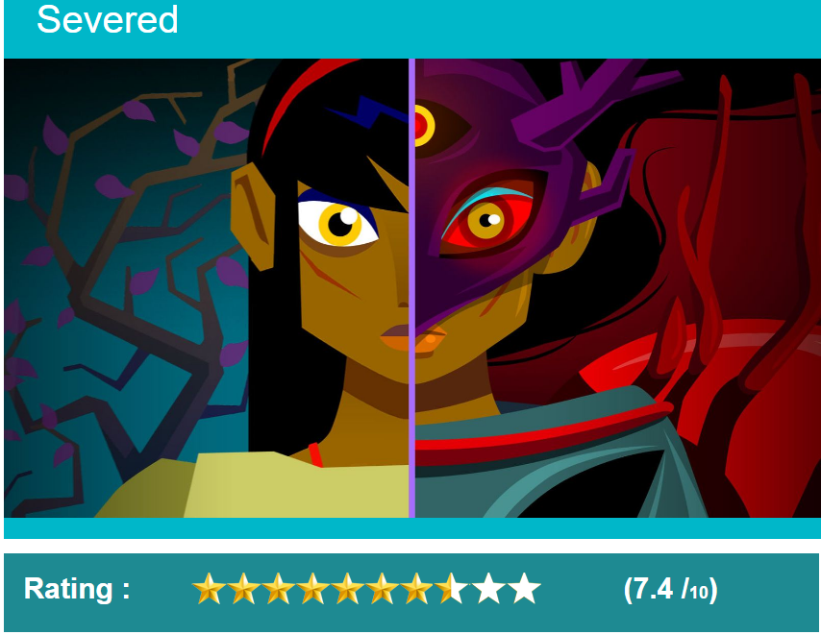
Game Rating

Slide 14
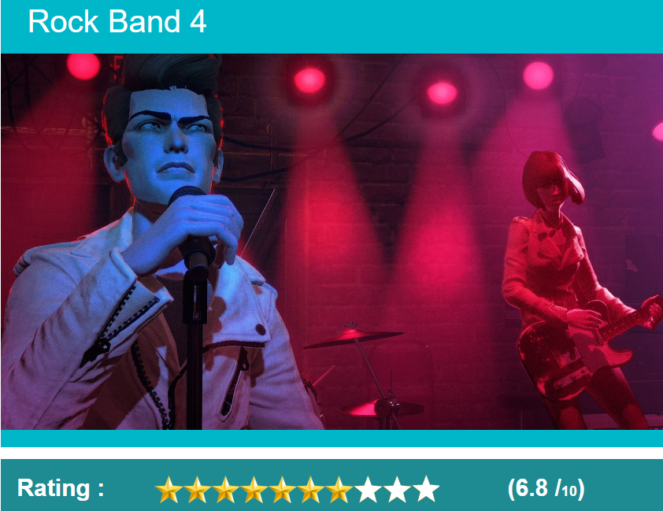
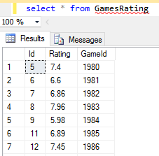

Slide 15
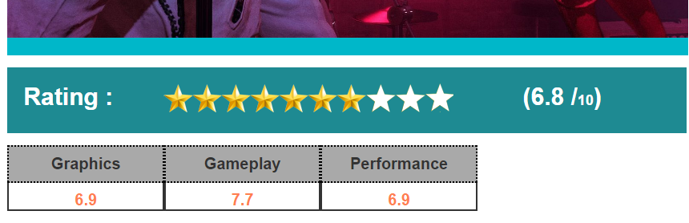
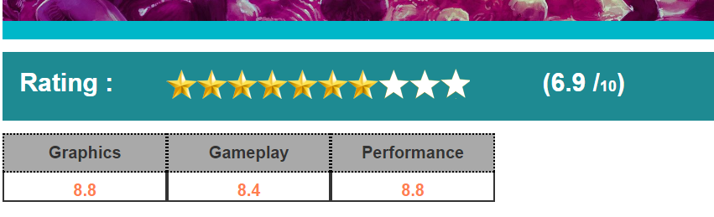
Feature Rating

Slide 16
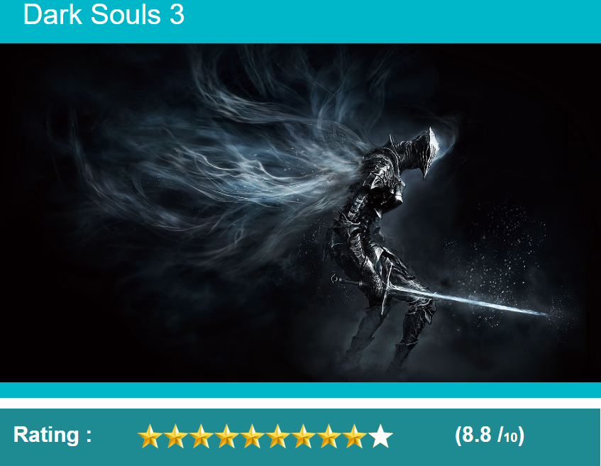
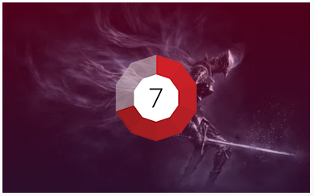

Notes:
Comparison

Slide 17
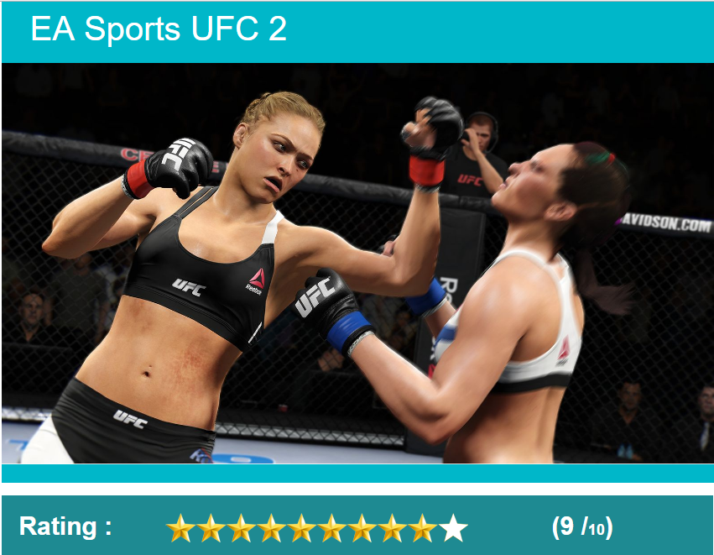
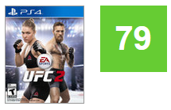
Notes:
Comparison

Slide 18
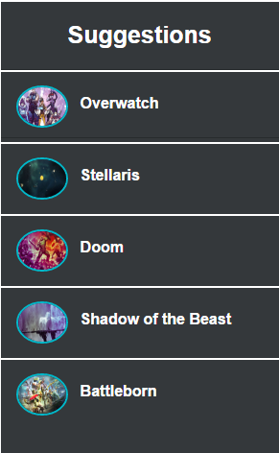
Suggestions
Top 5 matching
games
Notes:
Search-Based Methods

Slide 19
References
*Fellbaum, Christiane (2005). WordNet and wordnets. In: Brown, Keith et al. (eds.),
Encyclopedia of Language and Linguistics, Second Edition, Oxford: Elsevier, 665-670
*http://scholar.google.it/scholar?cites=10086709721837357519&as_sdt=5&sciodt=0
[1] | T. Obiwan, 02 05 2012. [Online]. Available: http://utdallas.edu/~sas071100/reqsproj/
[2] | K. S. a. J. E. Webber, "Trends that will define the future of video games," The Gaurdian, 23 July 2015. [Online]. Available: http://www.theguardian.com/technology/2015/jul/23/16-trends-that-will-change-the-games-industry.
[3] | Delen, "Trends shaping gaming industry," 27 10 2015. [Online]. Available: https://newzoo.com/insights/articles/how-games-are-shaping-the-future-of-digital-and-broadcast-media/.
[4] | E. Beardslee, "GAMER DEMOGRAPHICS," 12 10 2015. [Online]. Available: http://learn.mobilispot.com/mobile-gamer-demographics-to-target-in-2016.
[5] | A. Shaw, "Cultural Studies and Game Studies," University of Pennsylvania, Philadelphia, PA, USA, 18 09 2013. [Online]. Available: http://gac.sagepub.com/content/5/4/403.short?rss=1&ssource=mfr.
[6] | M. McNeill, "GAME REVIEW ANALYSIS," DeltaDNA, 02 06 2014. [Online]. Available: https://deltadna.com/blog/game-review-analysis/.

Slide 20
THANK YOU ☺

